Slide 1

Dallas Lunch and Learn
Alexa Skills - Primer

Slide 2
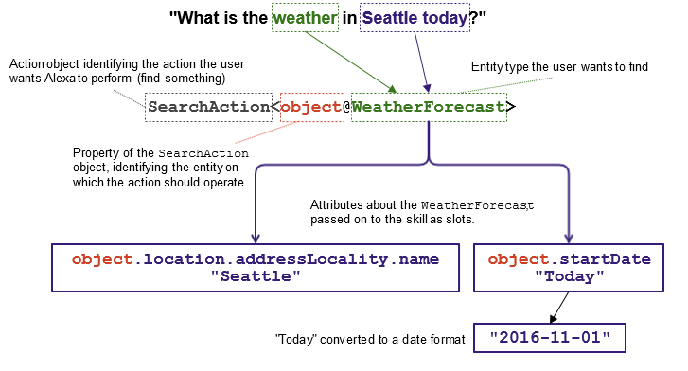
What is a Conversational UI
Like a GUI
CUI Represents a way to get data from a user to produce input into a workflow.

Slide 3
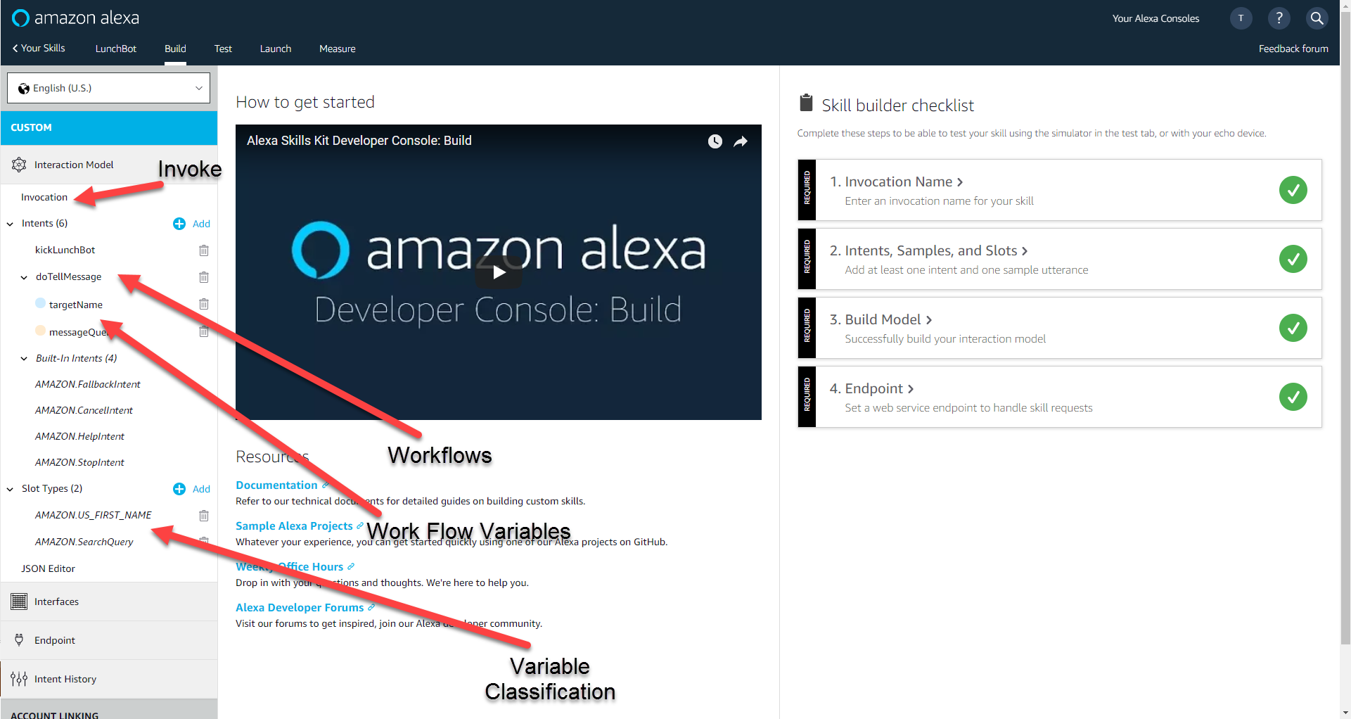
Alexa Skill Console

Slide 4
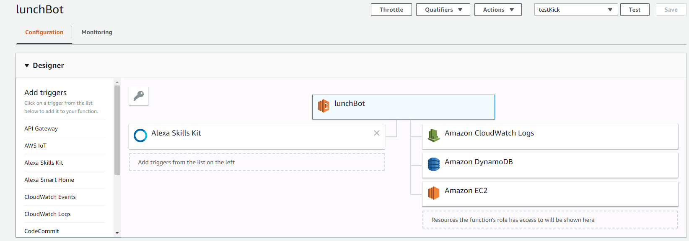
Lambda

Slide 5
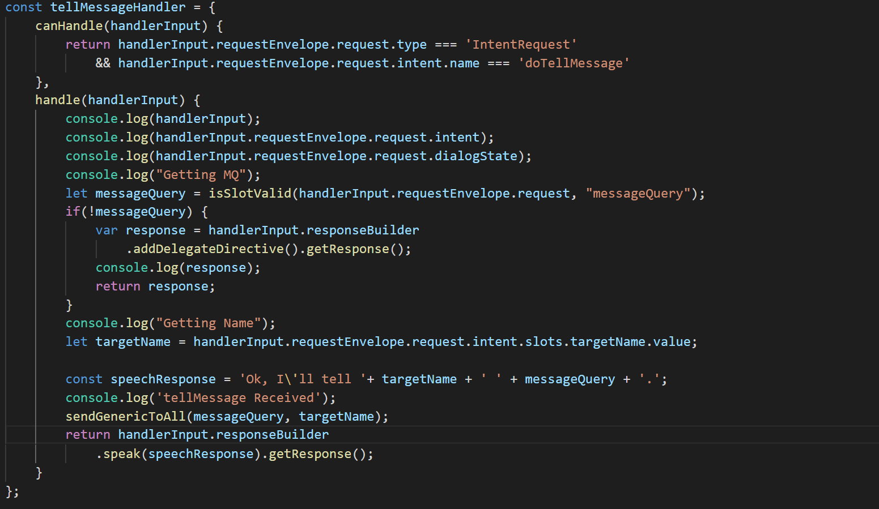
Code – How we process an intent

